Slide 1
Building chatbots with MS Bot Framework
Bot Activity

Slide 2
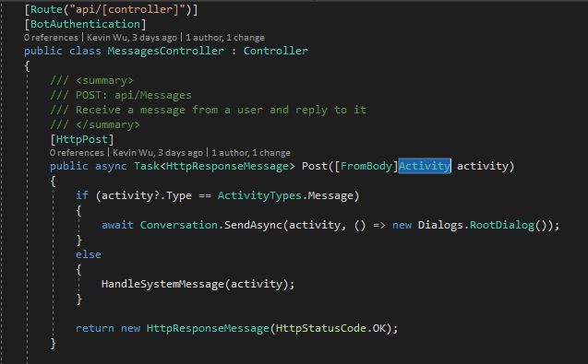
Microsoft.Bot.Connector.Activity
Highlight “Activity” -> Press F12

Slide 3
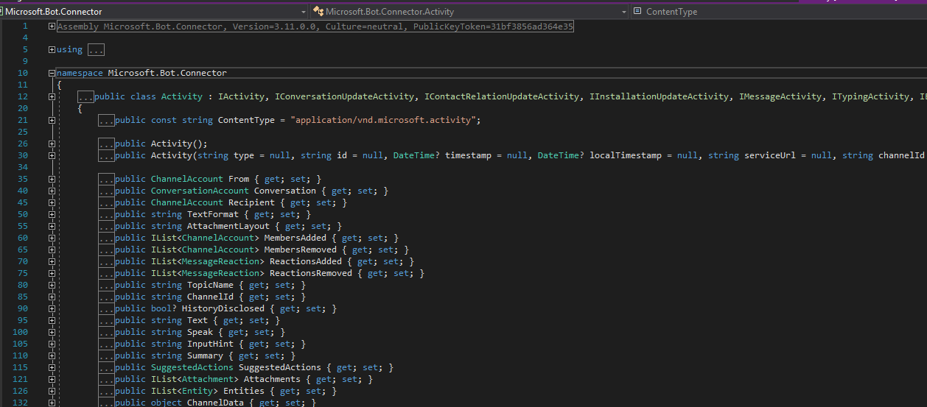
Microsoft.Bot.Connector.Activity

Slide 4
Microsoft.Bot.Connector.Activity
Channel Account
Conversation Account
User ID
Notes:
ChannelAccount type holds identity for users
ConversationAccount type holds identity for conversation
ID represents a unique identifier for a user on a channel

Slide 5
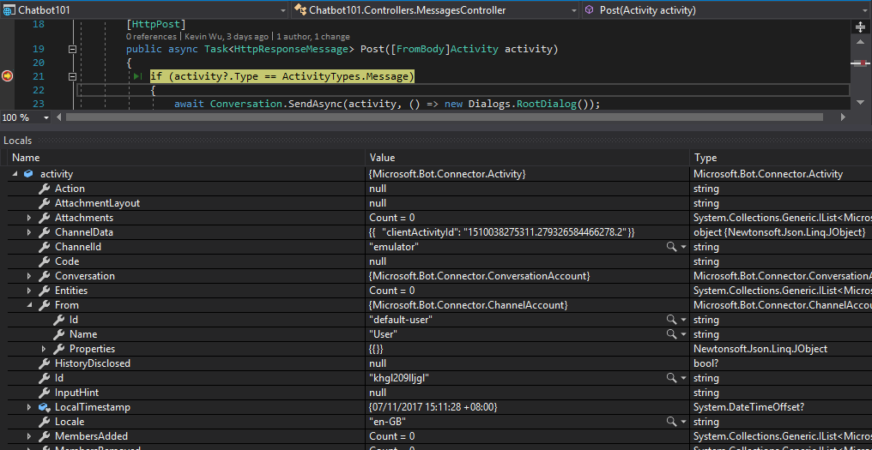
Microsoft.Bot.Connector.Activity
Channel: emulator
From: User ID
Message ID

Slide 6
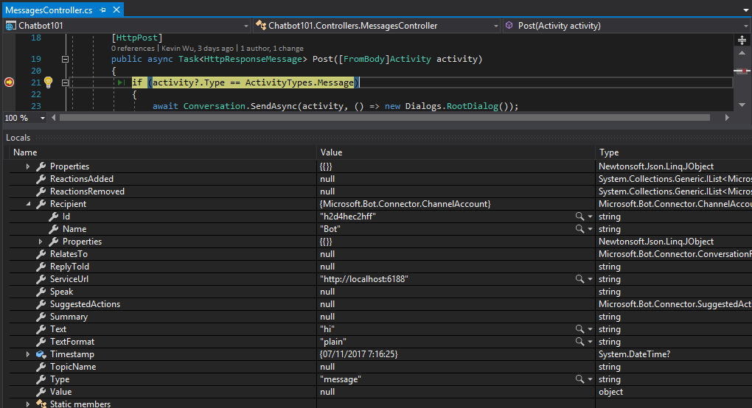
Microsoft.Bot.Connector.Activity
Recipient: Bot

Slide 7
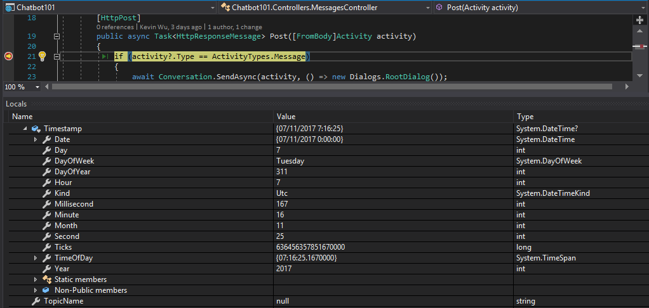
Microsoft.Bot.Connector.Activity

Slide 8
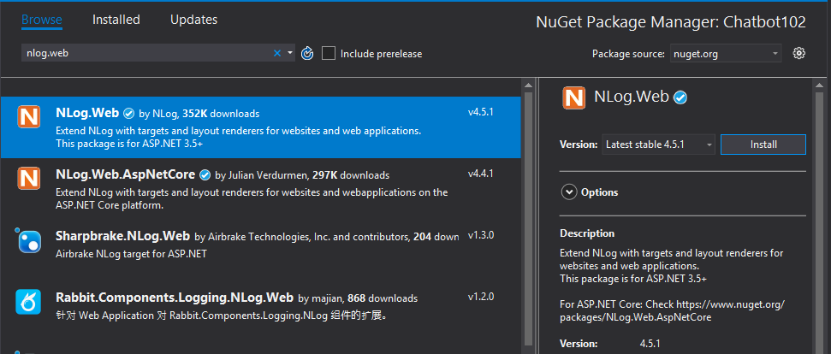
Install NLog

Slide 9
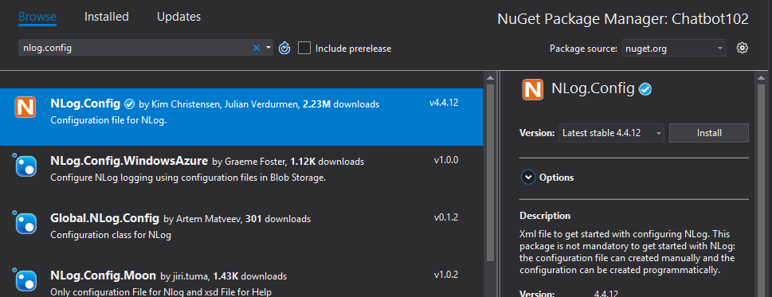
Install Nlog.Config

Slide 10
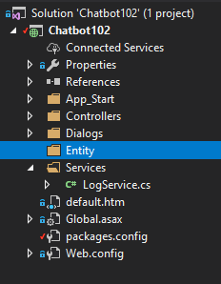
Create a new “Entity” folder

Slide 11
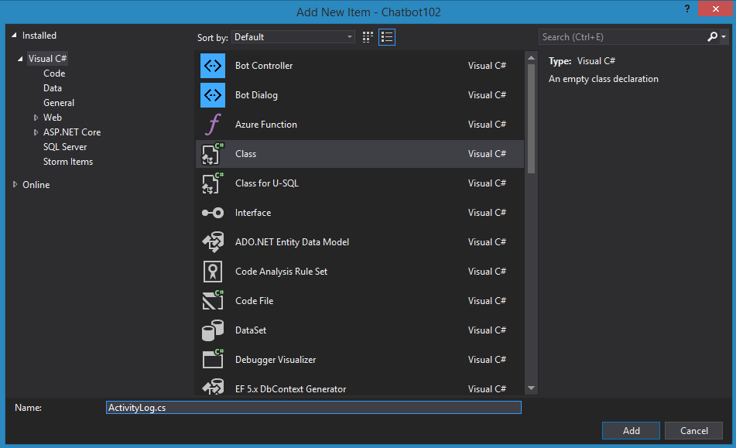
Create a new “ActivityLog.cs” class

Slide 12
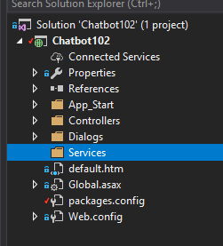
Add a new folder in Project

Slide 13
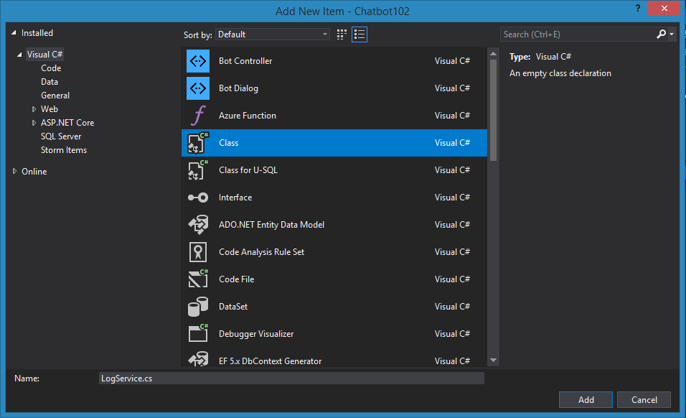
Add a new “LogService.cs” Class

Slide 14
Copy the code from this location
https://github.com/code-monster-kevin/chatbot-102/tree/log-activity
ActivityLog.cs
LogService.cs

Slide 15
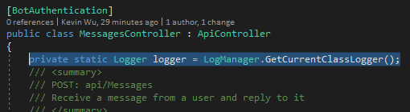
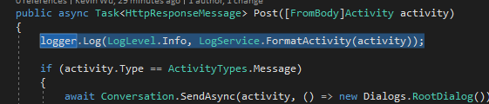
Add Logger code

Slide 16
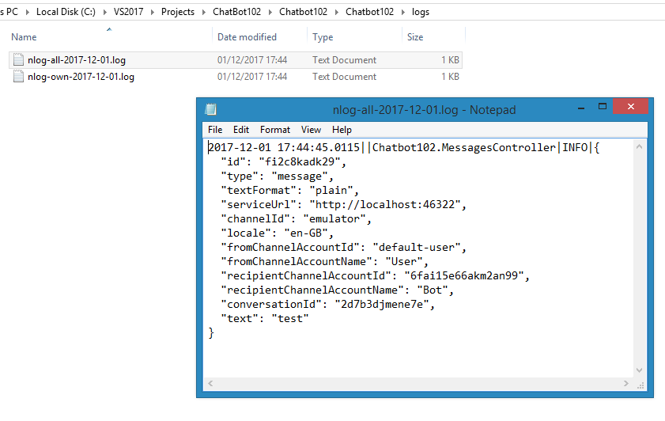
Run the application and type something in the bot emulator
You can find the logs
Under the project folder
Inside “Logs” folder

